Slide 1
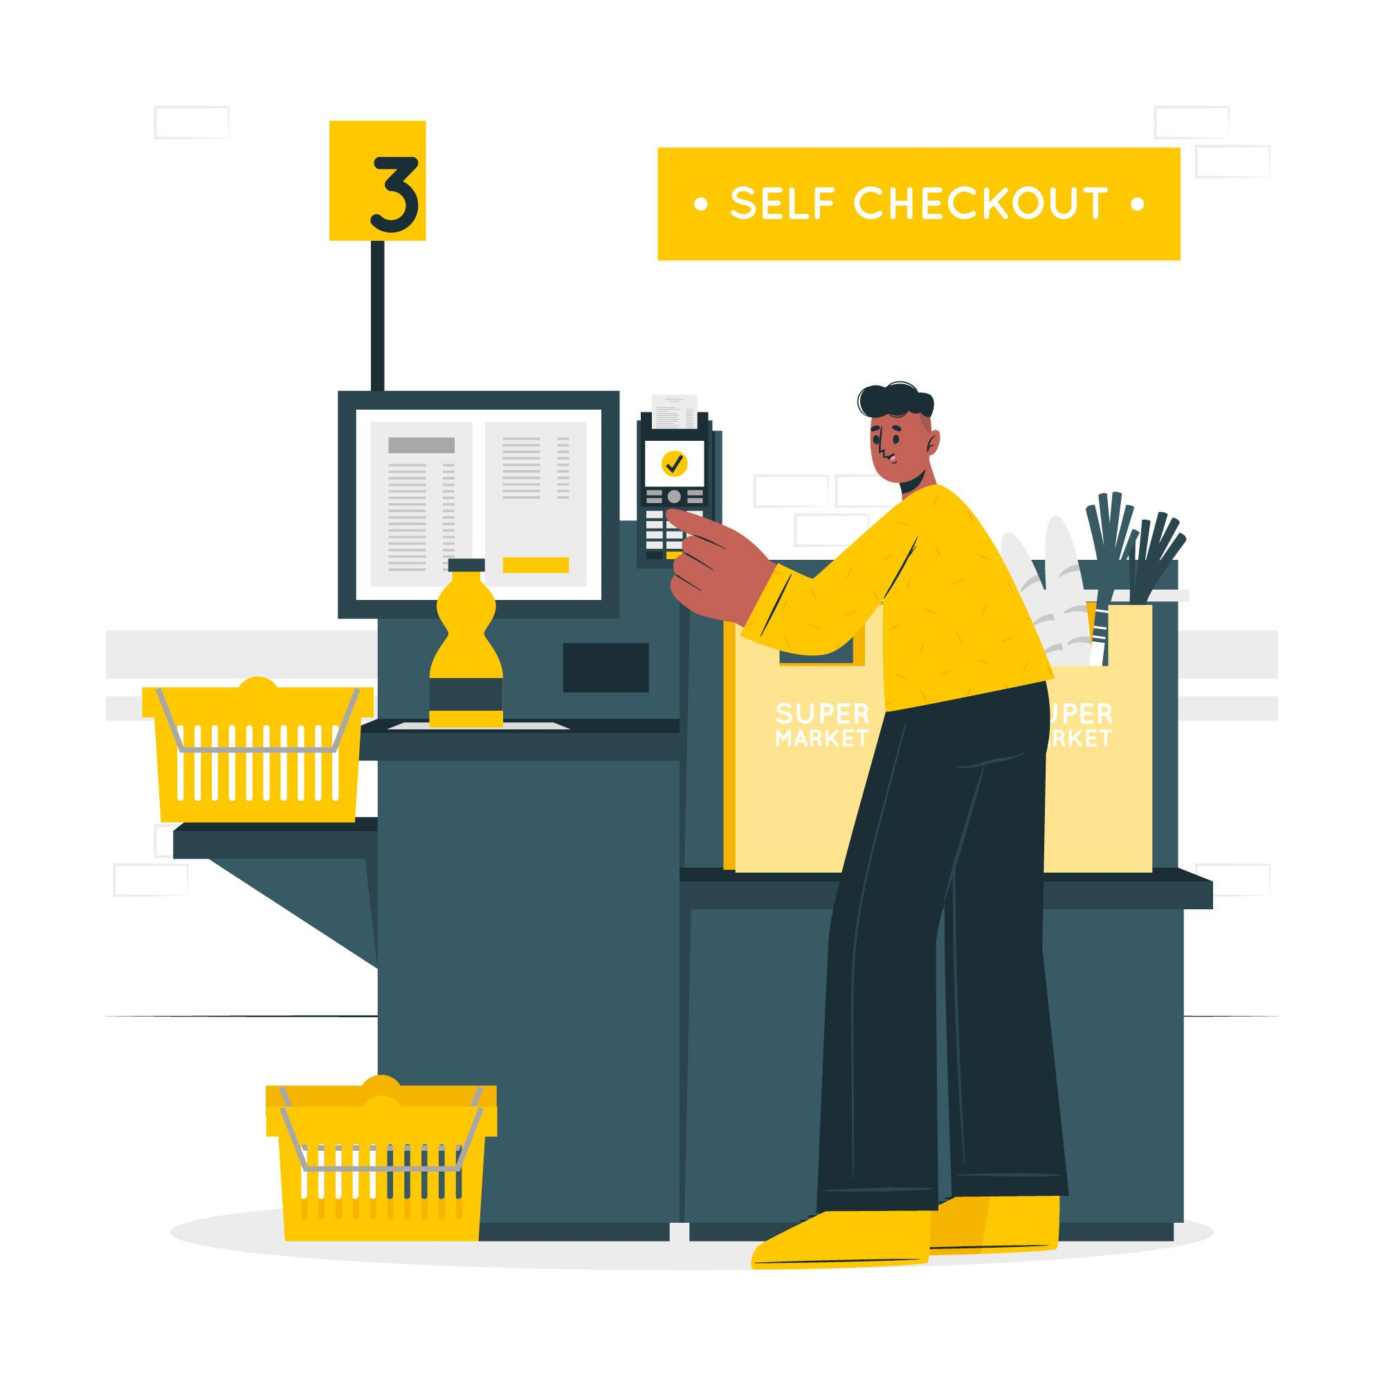

Scan, bag, and go – self-checkout made easy.
presented by Ali Riza Sevgili

Slide 2
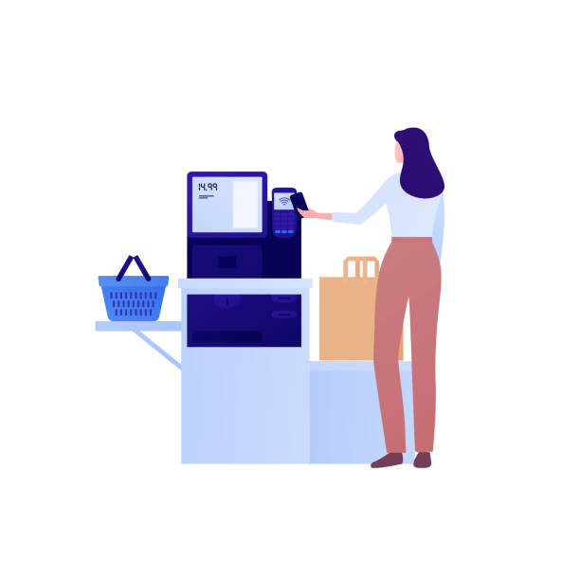
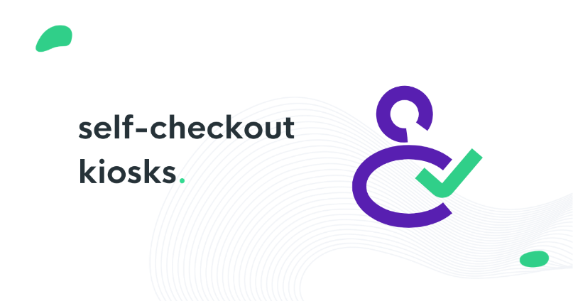
What is the Self Checkout System?
Customers can scan, bag, and pay for their items without the help of a cashier or other store employees using the Self-Checkout System, an automated system used in supermarkets and retail establishments.
Customers can complete their transactions independently using self-checkout kiosks or terminals rather than going through a traditional checkout queue with a cashier.

Slide 3

What are the advantages of the self-checkout system?

Slide 4
Efficiency Gains: Self-checkout machines help customers make purchases fast and easily. The total shopping process becomes more efficient and time-saving by doing away with the need to wait in lengthy checkout lines.
Reduced Wait Times: Self-checkout allows customers to skip lengthy lines at traditional checkout counters, especially during busy shopping times. Increased client satisfaction and return business result from this.
Savings: By automating the checkout procedure, companies can eliminate the need for additional cashiers, which could save money on labor costs. This might be very helpful for companies with limited resources.
24/7 Accessibility: Some self-checkout systems are able to run after regular business hours, enabling customers to make purchases even when conventional checkout lanes are closed.

Slide 5
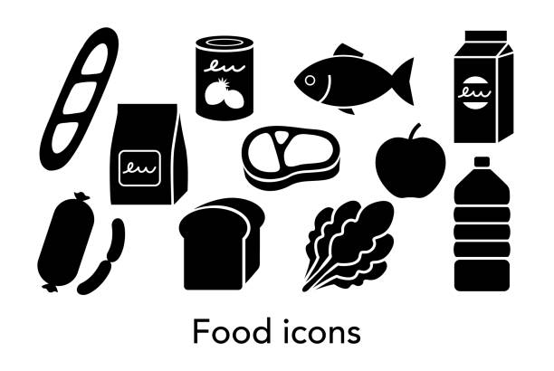
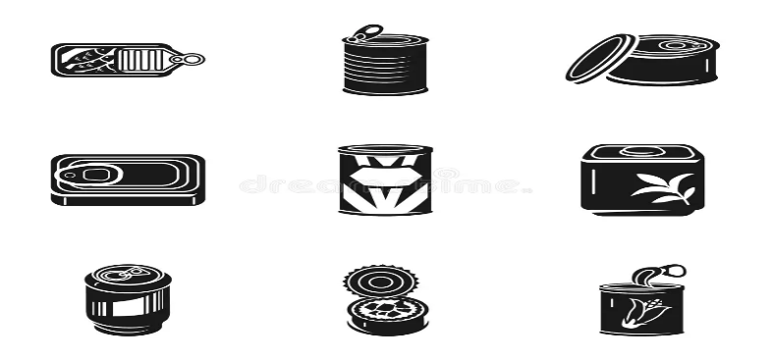
The Different Type of Products In Store
Perishable: These are items that can go bad or spoil relatively quickly if not stored properly. Examples include fresh fruits, vegetables, dairy products like milk and cheese, and meats. They need to be kept in cool environments like refrigerators to stay fresh.
Non-Perishable: These are things that don't spoil easily and have a lengthy shelf life. Examples include beverages in bottles, dried commodities like pasta and rice, and canned foods. They can be kept for a very long period at room temperature without becoming bad.

Slide 6

THIS IS A GREAT SOLUTION
First and foremost, we set out to clearly and completely clarify and explain the issue at hand.
We described the functionality of the self-checkout system for the two categories of merchandise (perishable and non-perishable).
Also noted are several advantages of self-checkout.

Slide 7
THANK YOU !

